Slide 1
Booth
Family tree

Slide 2
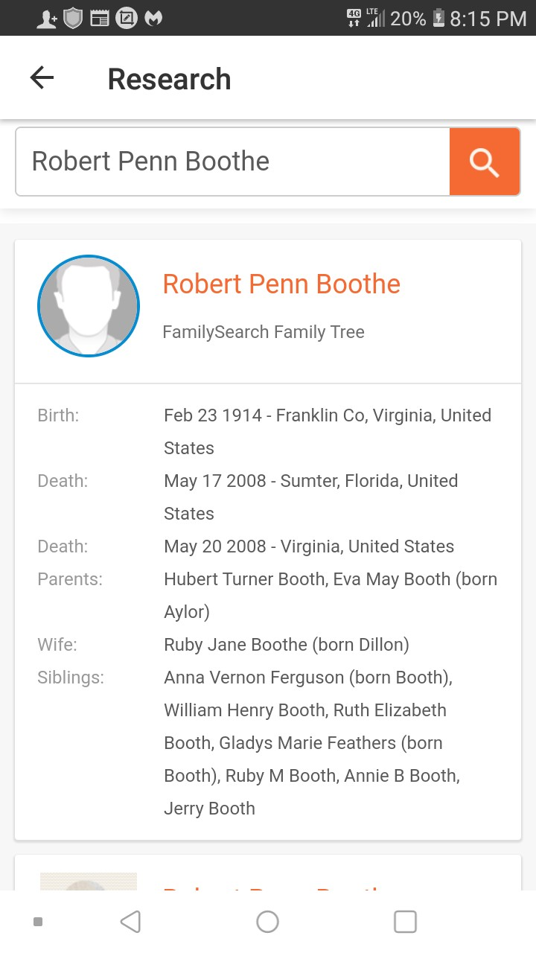
Grandaddy Robert Penn Boothe

Slide 3
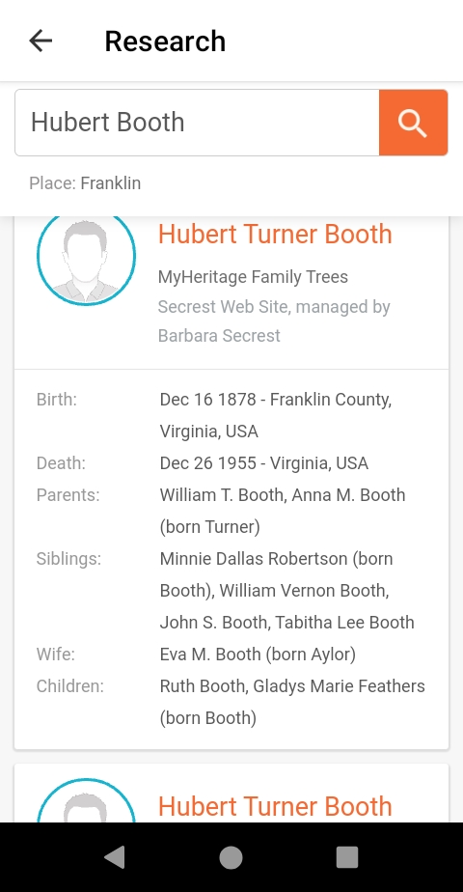
Hubert Booth great grandfather

Slide 4
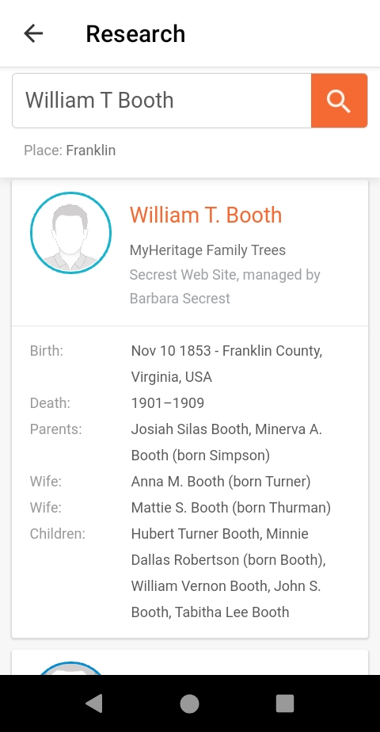
William Turner Booth 3 greats

Slide 5
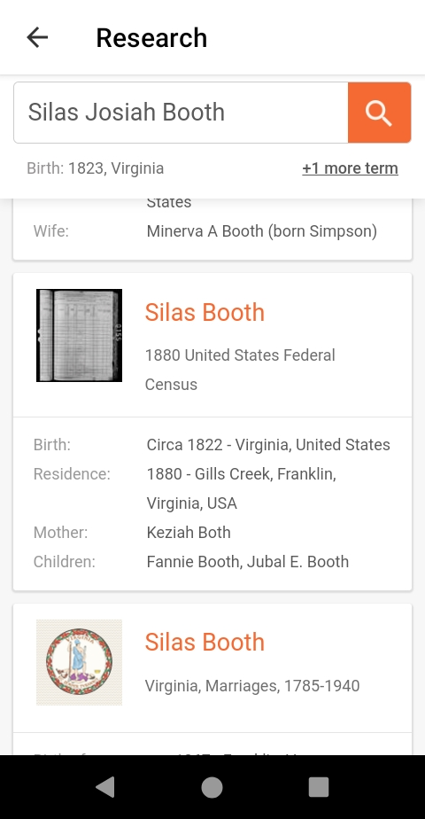
Josiah Silas Booth 4 greats

Slide 6
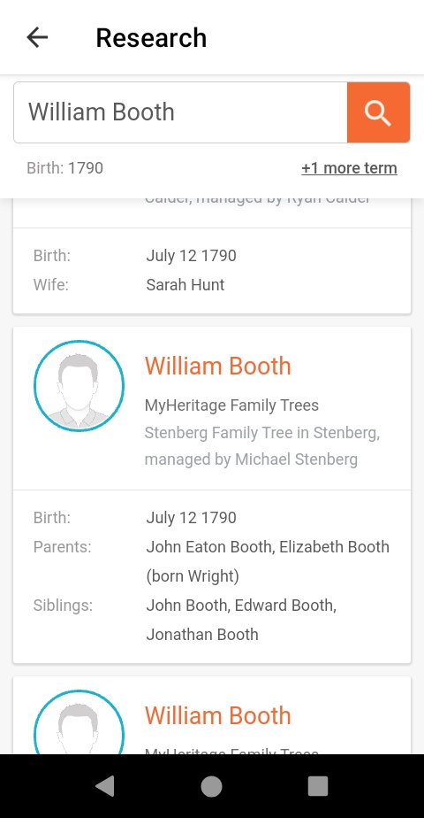
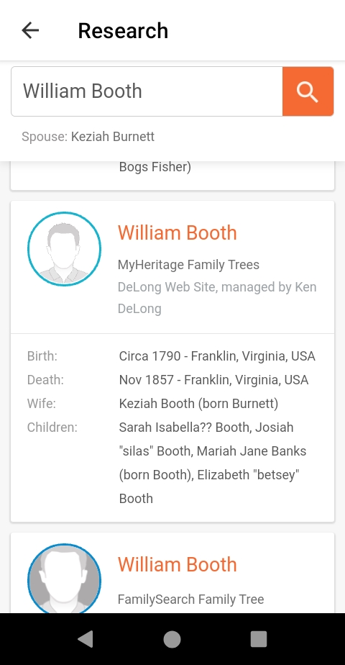
William Booth 1790 birth in Franklin

Slide 7
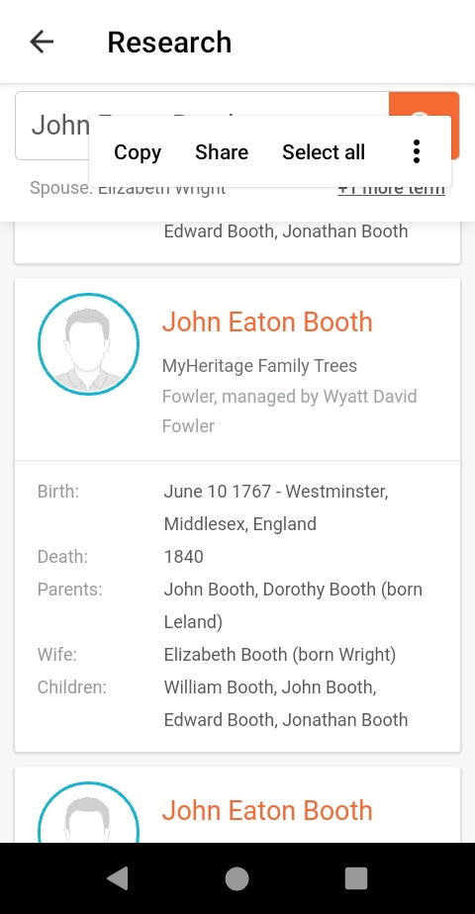
John Eatom Booth in England

Slide 8
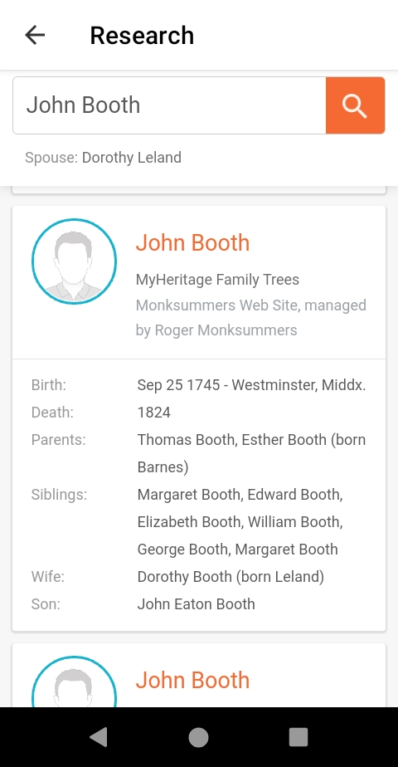
John Booth

Slide 9
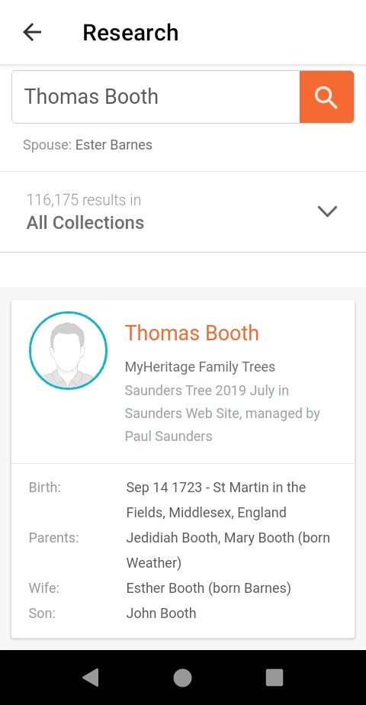
Thomas Booth

Slide 10
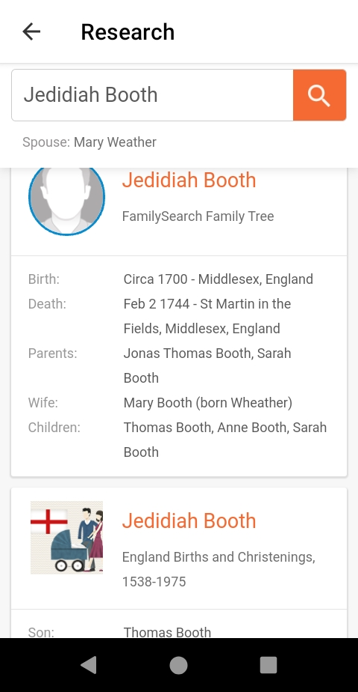
Jedidiah Booth

Slide 11
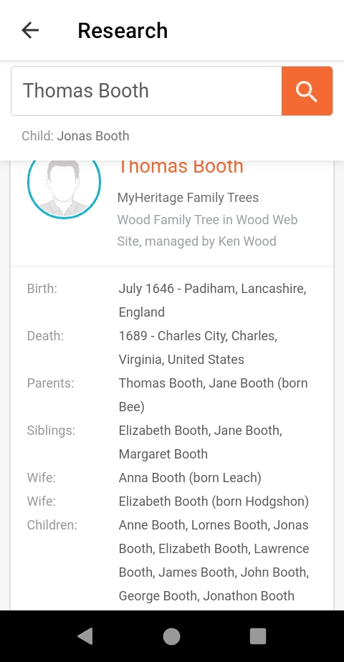
Thomas Booth from England to USA

Slide 12
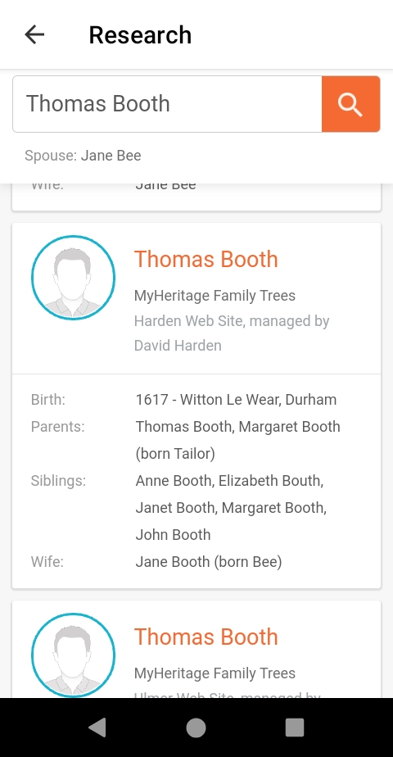
Thomas Booth way back England

Slide 13
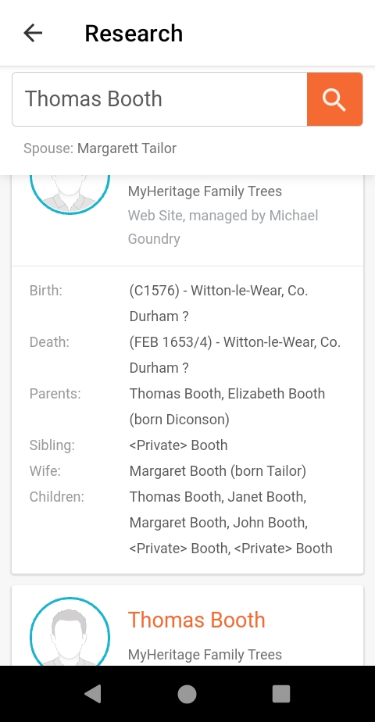
Thomas Booth again see dates and names

Slide 14
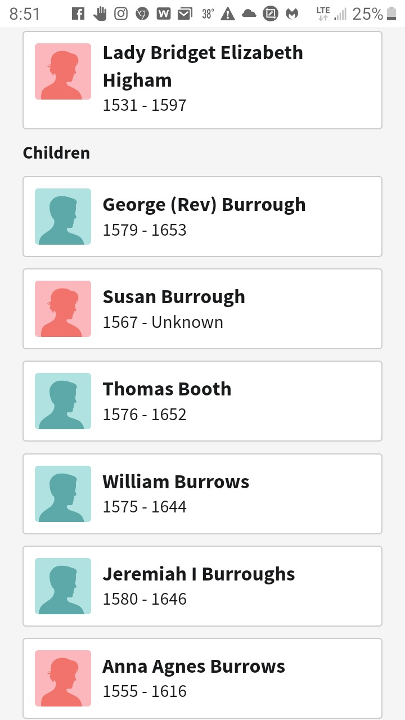
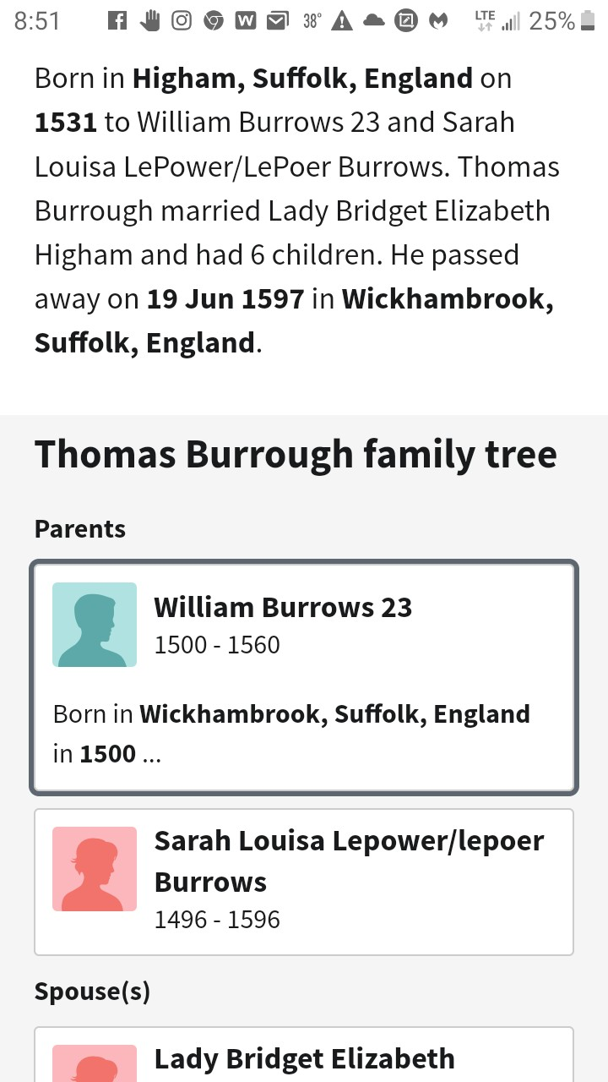
Plantagenet bloodline is here!

